Slide 1
Terminal App:
Core 🌳
Blaise

Slide 2
What is it?
Cafe application.
For a new cafe in the heart of brisbane.
Providing all the standard features need for a cafe app in today’s business world.

Slide 3
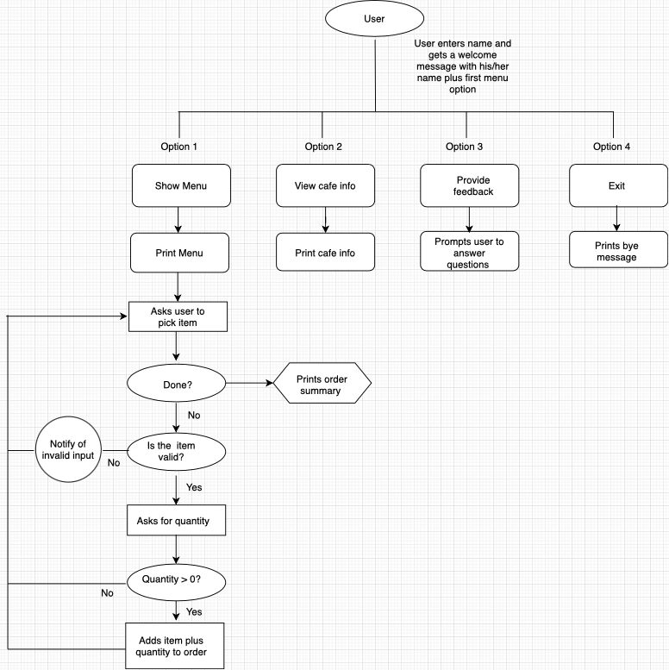
Flowchart

Slide 4
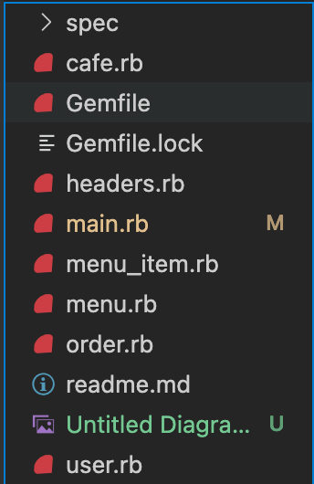
Structure
Main.rb
Cafe.rb
Header.rb
User.rb
Order.rb
Menu.rb
Menu_item.rb

Slide 5
Features
01
Takes orders
02
Provides feedback from user
03
Display Info/input info

Slide 6
Challenges/favorite part
Challenges:
Breaking down the idea
Time management
test
Favorite part:
Creating something something that works!

Slide 7

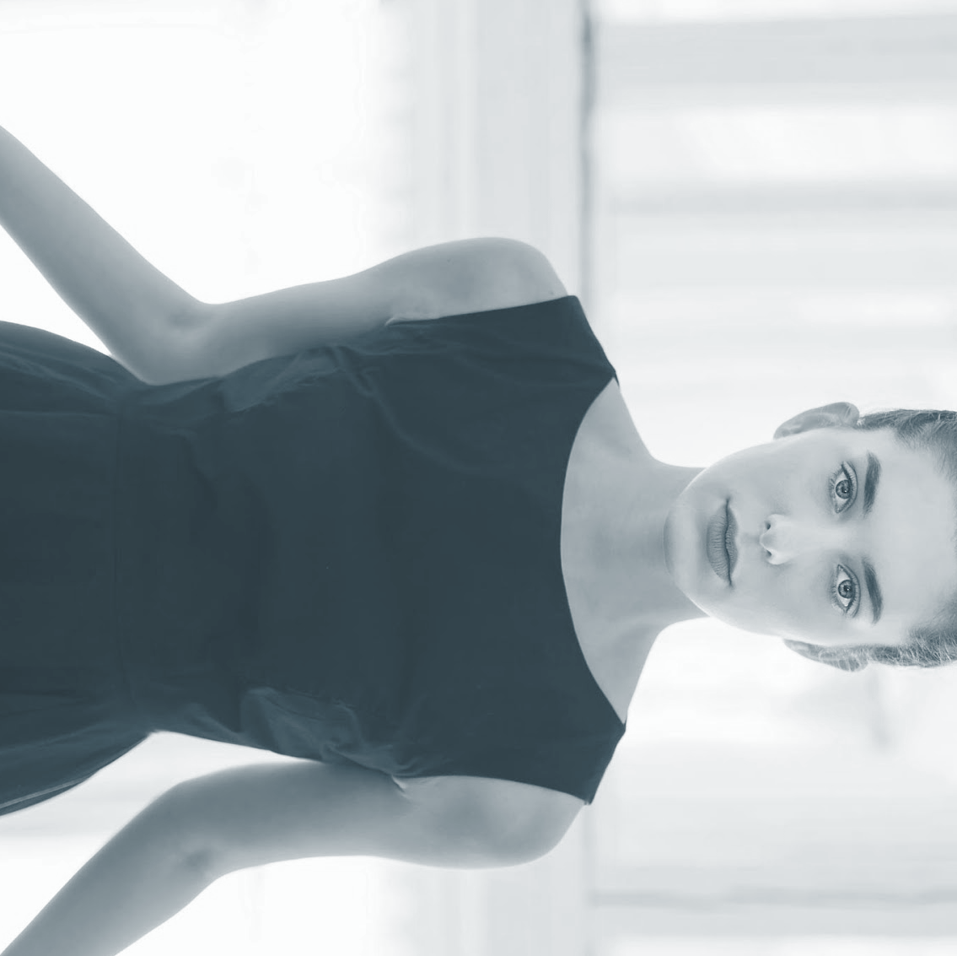
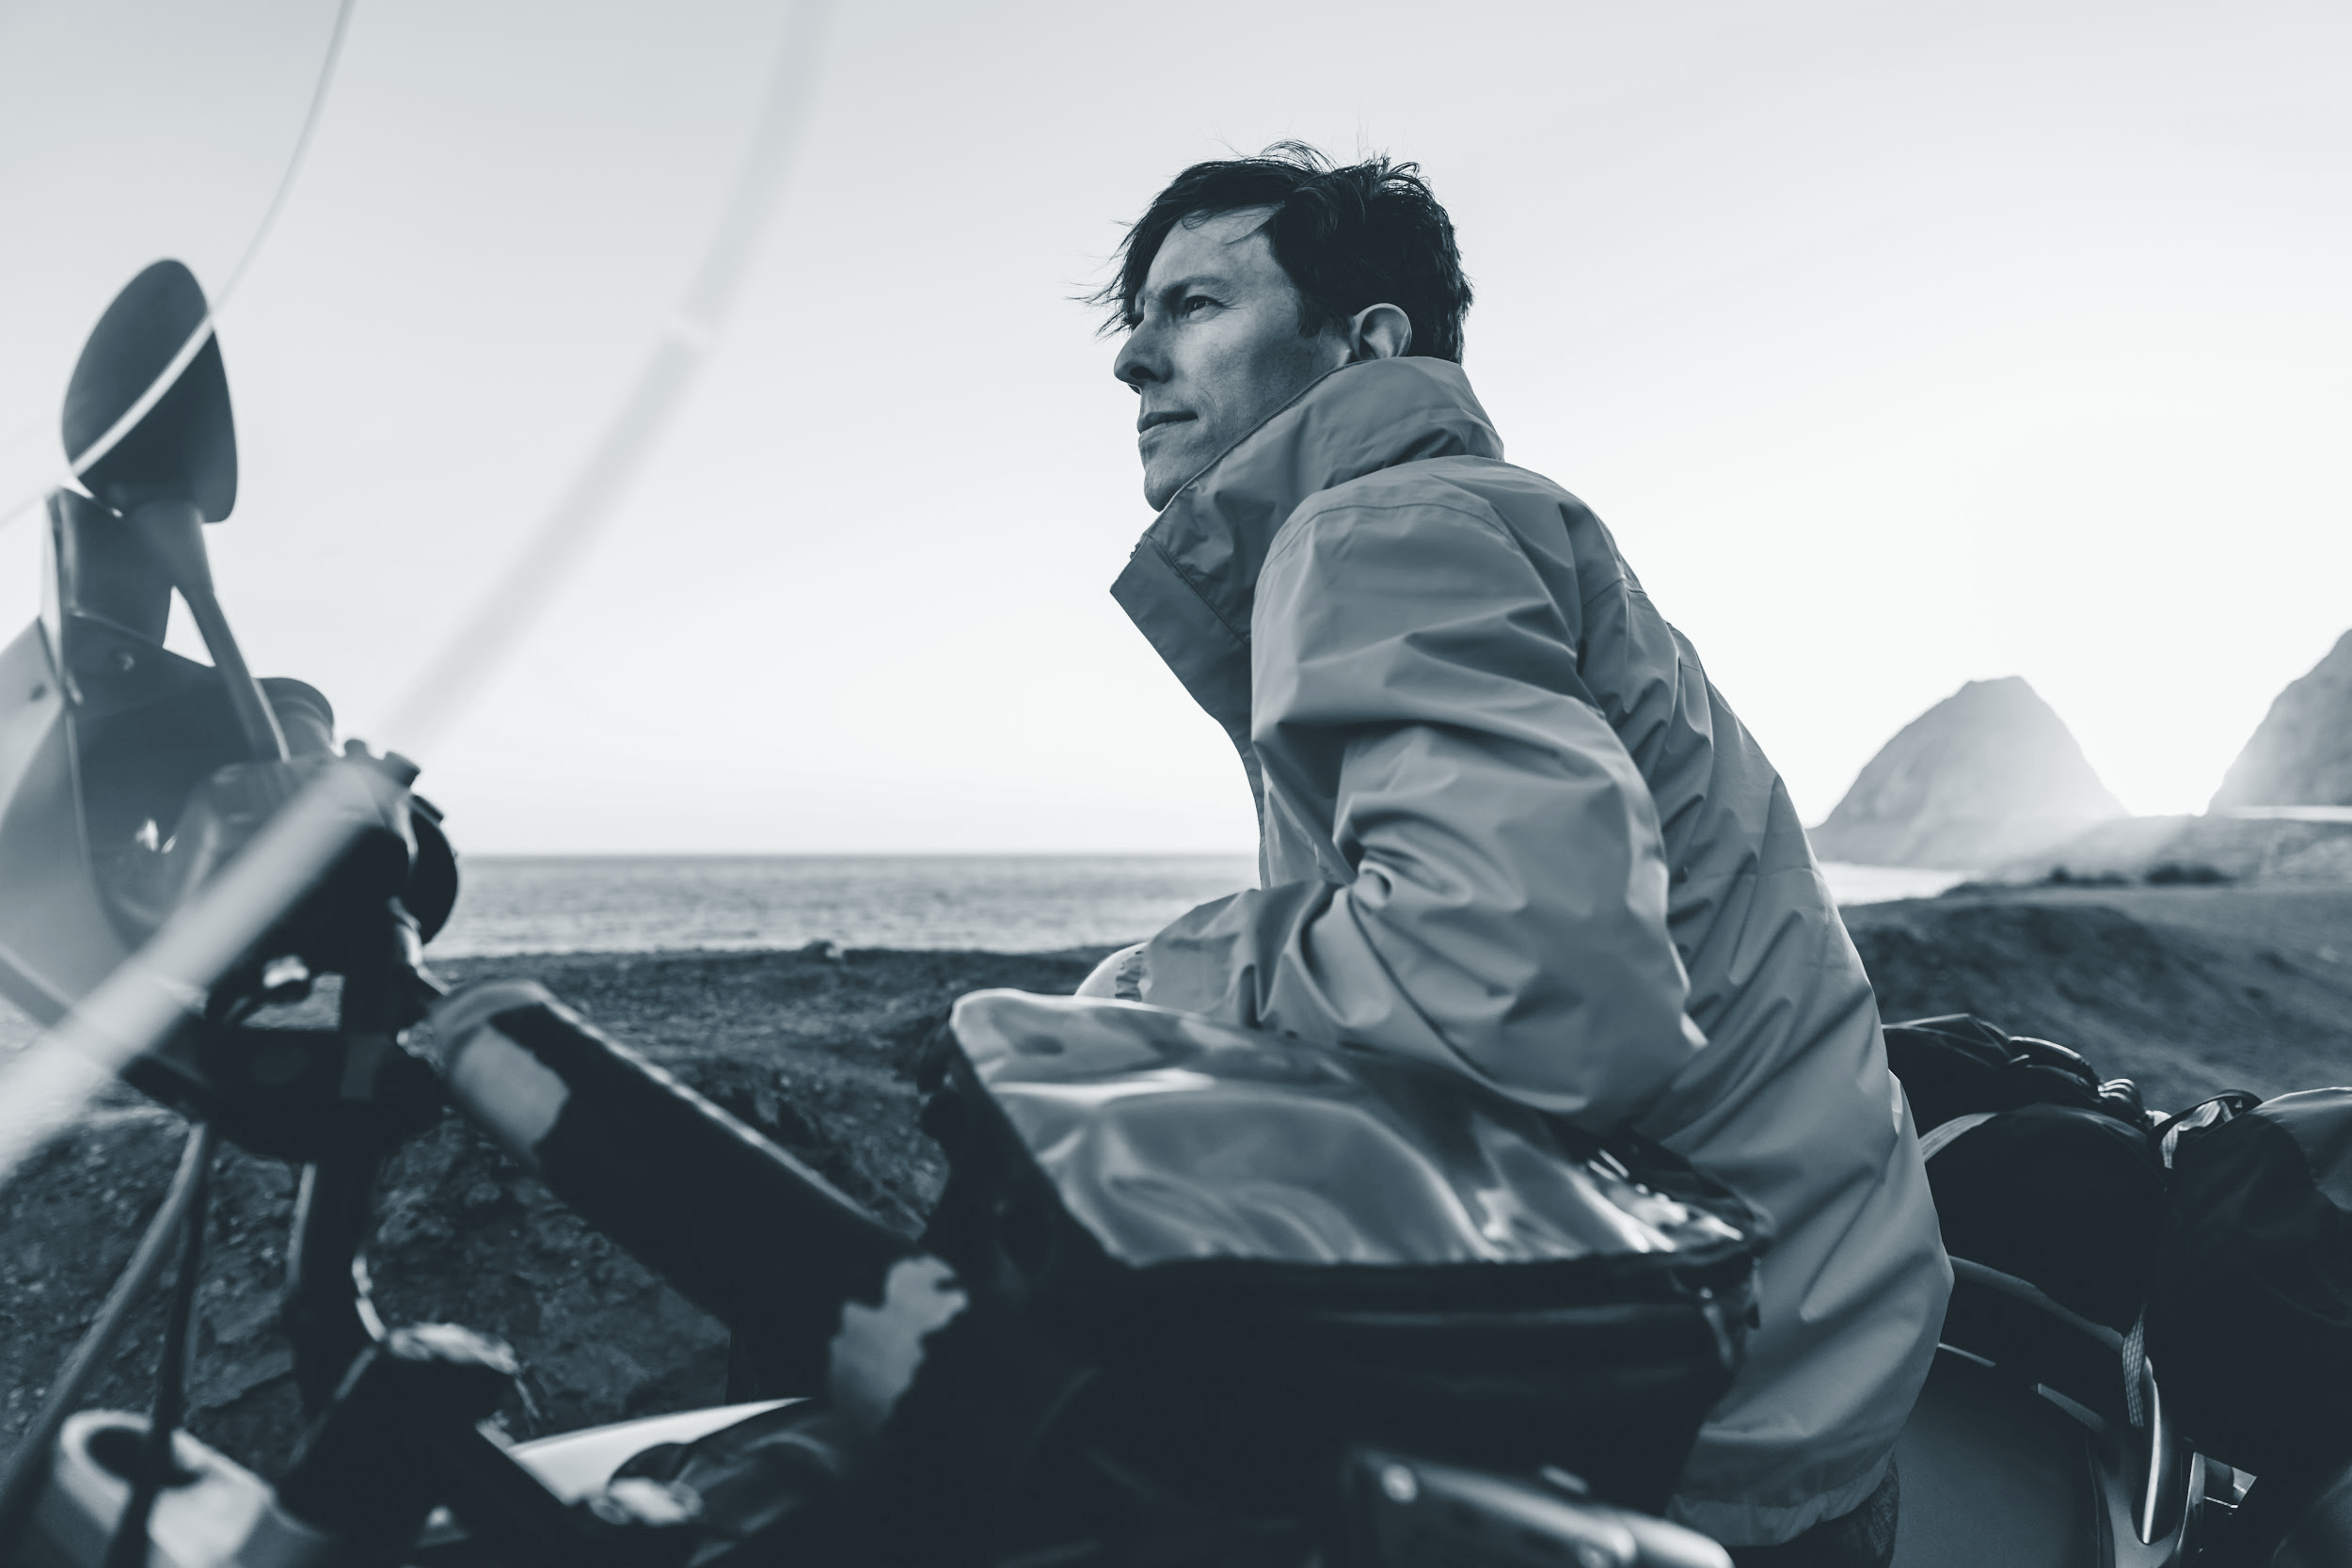
FIN

